Slide 1
Tool Update 6/29/24

Slide 2
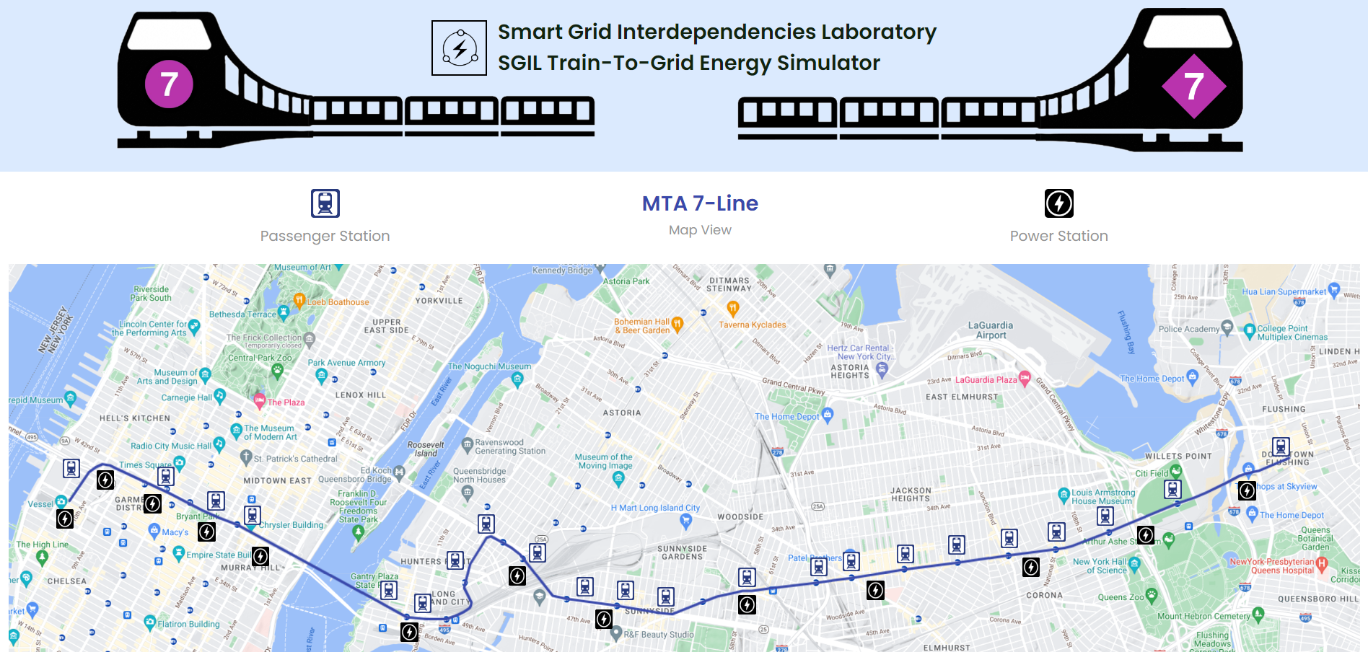
I think the title should directly state what the tool is. Something like:
“NYCT 7-Line Power Consumption Calculator”
“Subway DER Integrator”
Perhaps you know better wording. But something more direct I feel.
Also, I think better right under add a line in smaller font that says “Your personal DER Integrator”
This should be a header on the top left I feel.
Note: We will need to redesign the header if you want to make it left because according to me it looks perfect in the center
Let’s color this background something other than white, maybe light blue?
I think better to make this icon a different color rather than just black. Red?
Add border to map
Let’s use a more intriguing font
Let’s add a legend on the bottom right that lists the icons instead

Slide 3
Add hoverable text here that says: “What are DERs?”
When end-user hovers mouse over the text, a tooltip/description appears that says:
Distributed Energy Resources (DERs) are small-scaled devices that generate, store, or consume energy. They allow for independent operation away from the power grid, thereby producing cleaner energy.

Slide 4
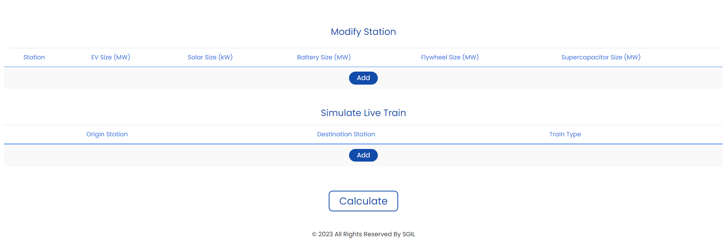
Let’s color this background something other than white, maybe light blue?
Add DERs
Add Train
Service

Slide 5
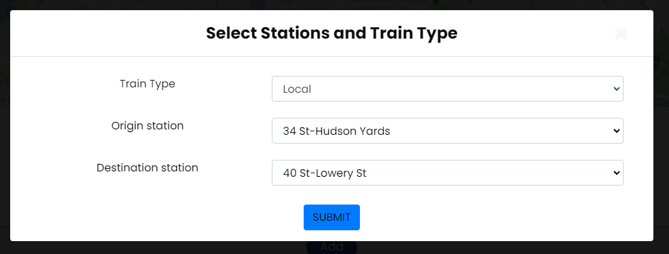
Service
S
S

Slide 6
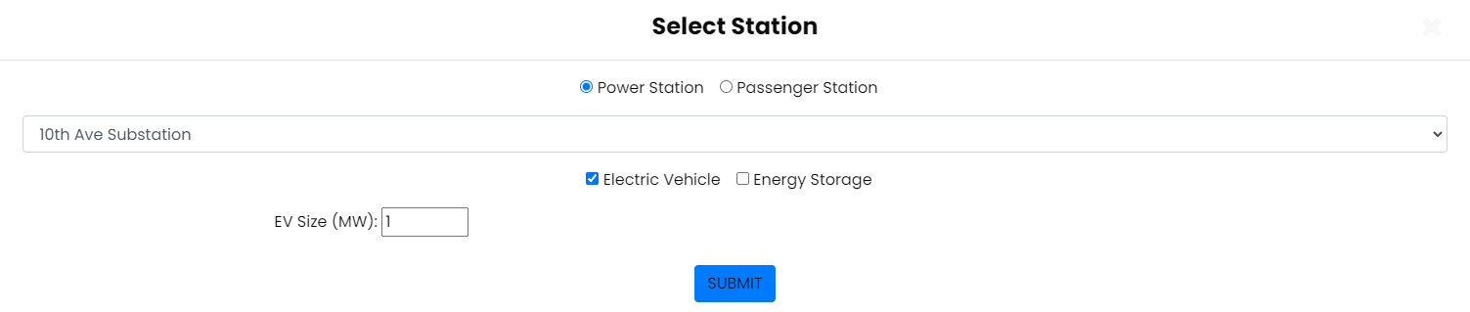
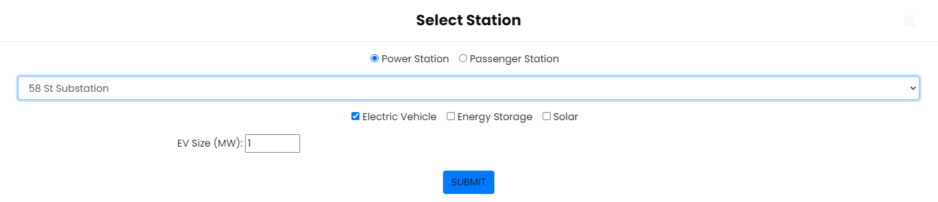
Let’s decrease width of box and center number
For stations like 10th Ave where Solar is not available, I think let’s still show the Solar icon but have it grayed out and unclickable. When end user hovers mouse over it, it says:
Solar option unavailable for underground station

Slide 7
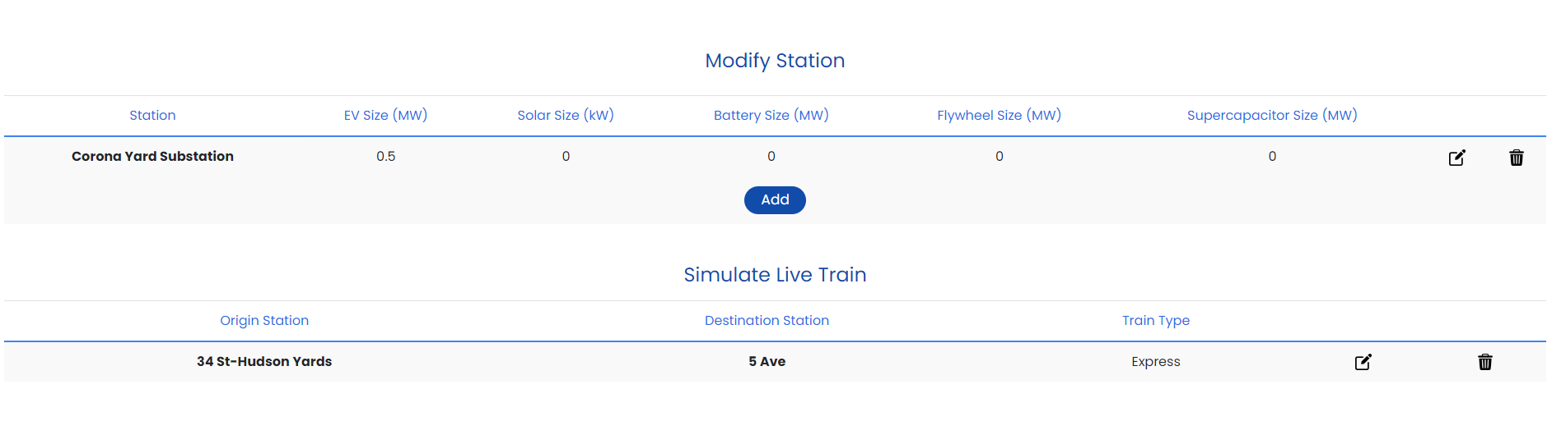
Remove bold

Slide 8
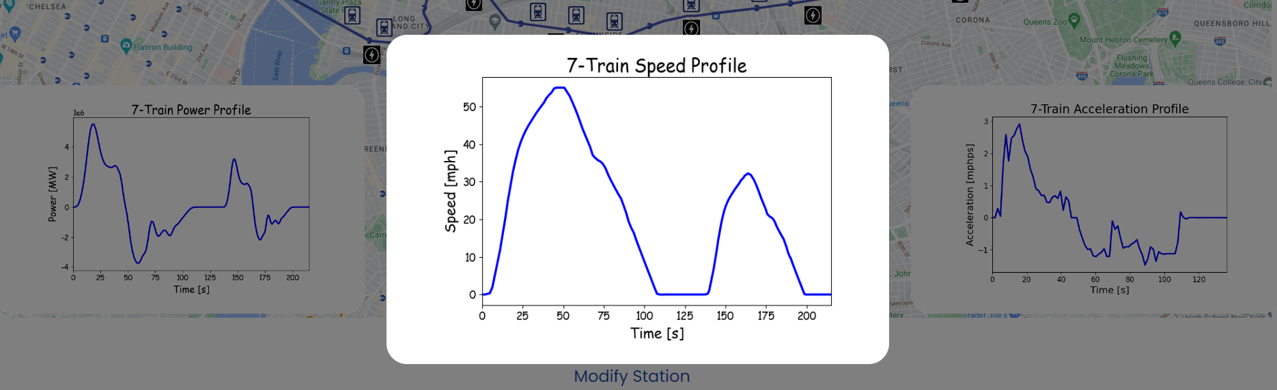
Add clickable arrows so that user knows he can go right and left?
Maybe we can use this font throughout the software?
Note: These fonts are paid we have to purchase those fonts to use this in complete site
I like how you did these graphs. I think better to make the background a different color other than white. I might have to do that in the python code.
Note: This is Image cannot change background color

Slide 9
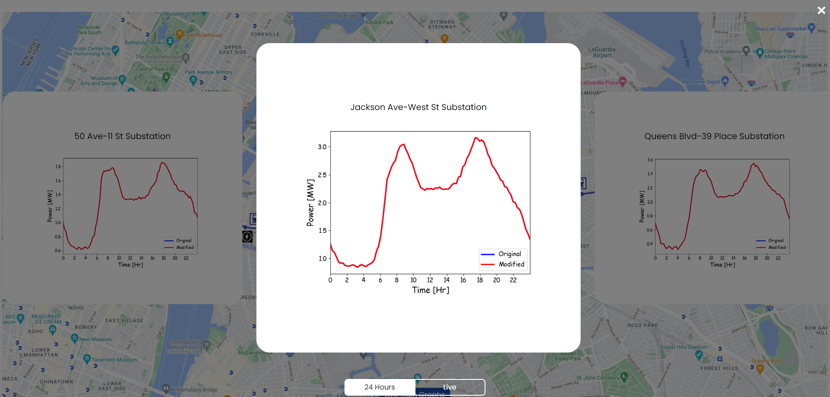
Different background color?
Note: This heading and graph are the part pf image and if I change the background color you’ll have to recreate all the images.
Big gap
In the Python code let’s change the legend:
Without Selected DERs
With Selected DERs
Or something you feel better words it and is shorter
Big gap

Slide 10
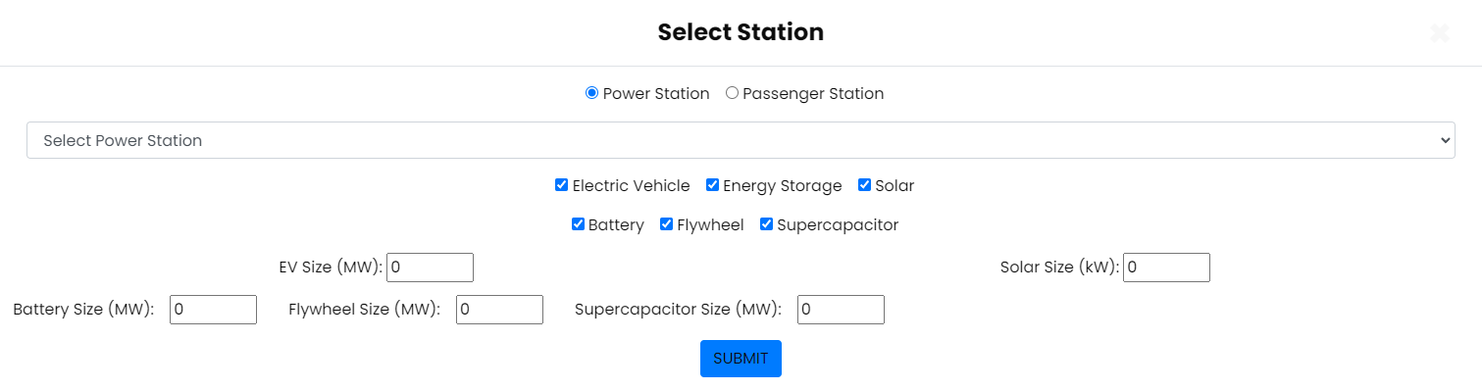
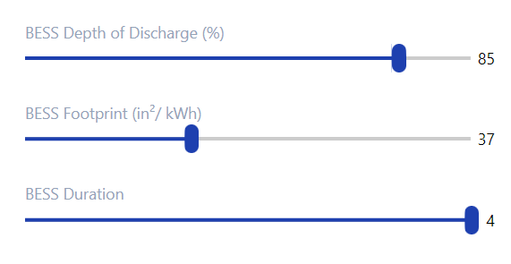
When user hovers mouse over size, textbox appears that says:
“Selected EV Size”
In brackets, indicate range for each option to the right, e.g., [0-1]
OR MAKE IT ALL SELECTABLE WITH A BAR LIKE YOU DID NICELY IN YOUR LOAD ANALYSIS SOFTWARE
This way user can see the range and no need for error message that says something too large was selected.

Slide 11
Add a textbox at the bottom that says something like:
Note: Sizing options depend on load capacity and available infrastructure space

Slide 12
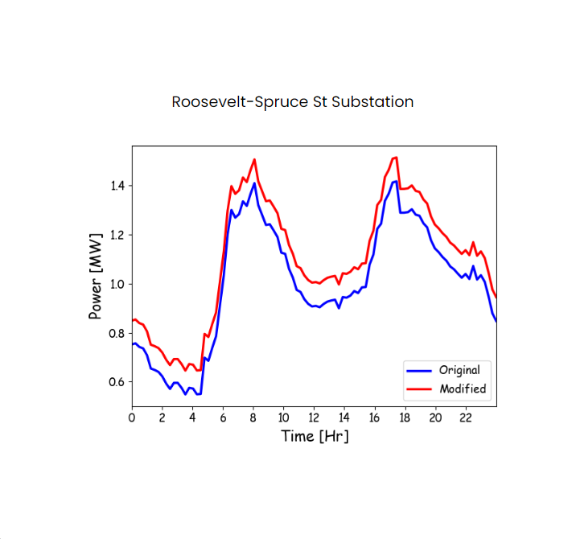
I can add text in the center that lists:
Peak Demand Reduction:
Energy Savings:

Slide 13
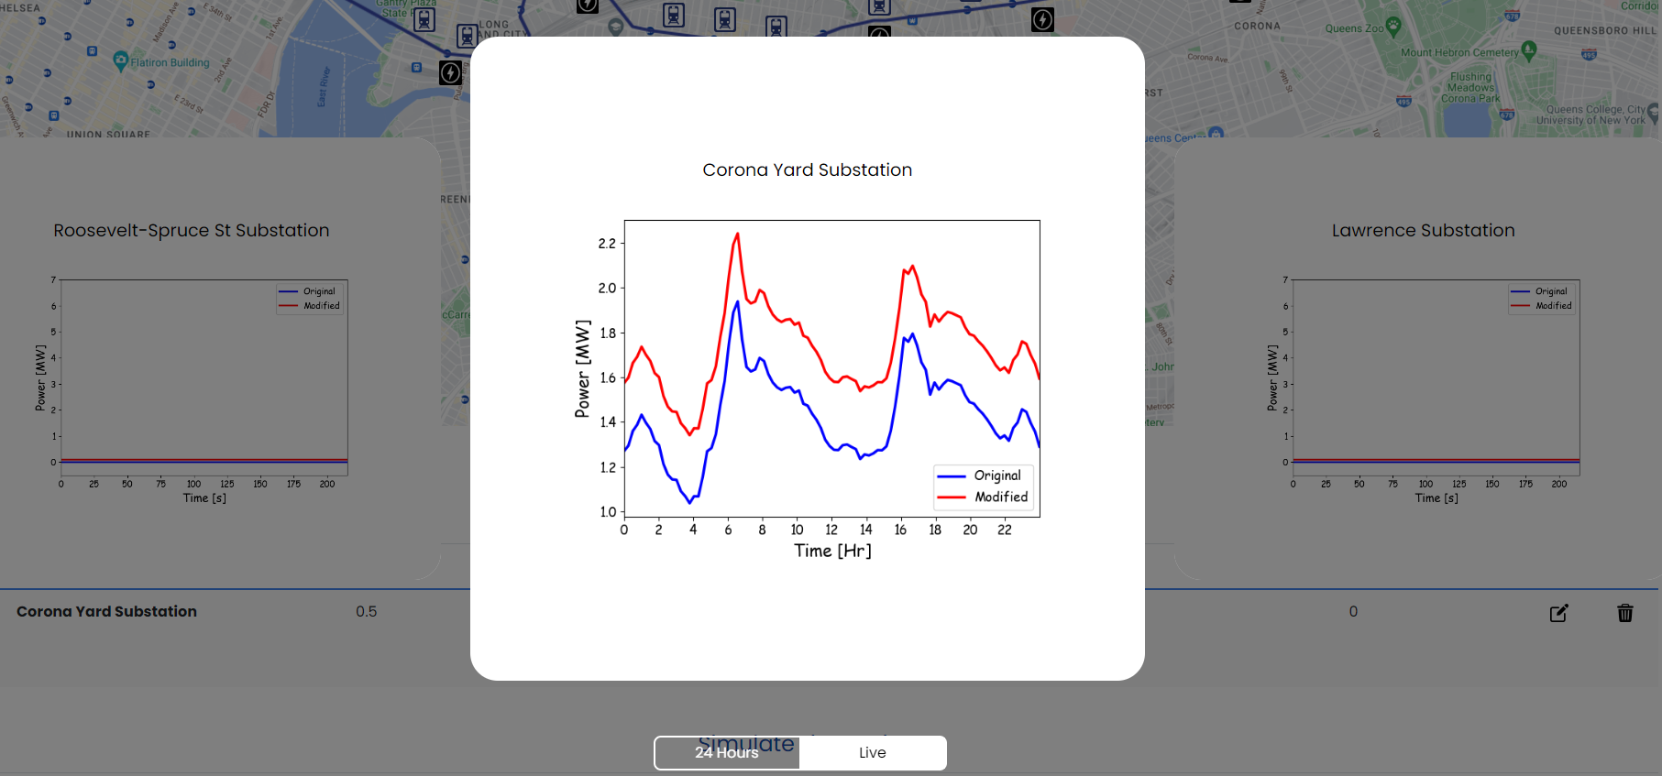
ERROR
The 24 Hr is showing. The other stations changed to Live but this substation is still showing 24 Hr

